Slide 1
Good Engine Prediction
Name-sai bharath dhanekula
Id-1568, B-34

Slide 2
Agenda
Problem Statement
Data Understanding
Data Arrangement
Data Preprocessing
Data Visualization
Model Building
Conclusion

Slide 3
Problem Statement
To predict whether an engine is likely to pass the manufacturing test.
So, How it is done ?
Finding the relation b/w attributes

Slide 4
Data Understanding
Files-
Train, Additional_Train
Test, Additional_Test
Train dimensions- 3157x22
Test dimentions-1054x21

Slide 5
Data Understanding
Attributes
ID
Y
Number of Cylinders
material grade
Lubrication
Valve Type
Bearing Vendor
Fuel Type
Compression ratio
cam arrangement
Cylinder arrangement
Turbocharger
Varaible Valve Timing (VVT)
Cylinder deactivation
Direct injection
main bearing type
displacement
piston type
Max. Torque
Peak Power
Crankshaft Design
Liner Design

Slide 6
Data Arrangement
Why?
No data lose
Merge

Slide 7
Data Prepocessing
3160 NA values,
158 each coloumn
Central imputation
Knn imputation

Slide 8
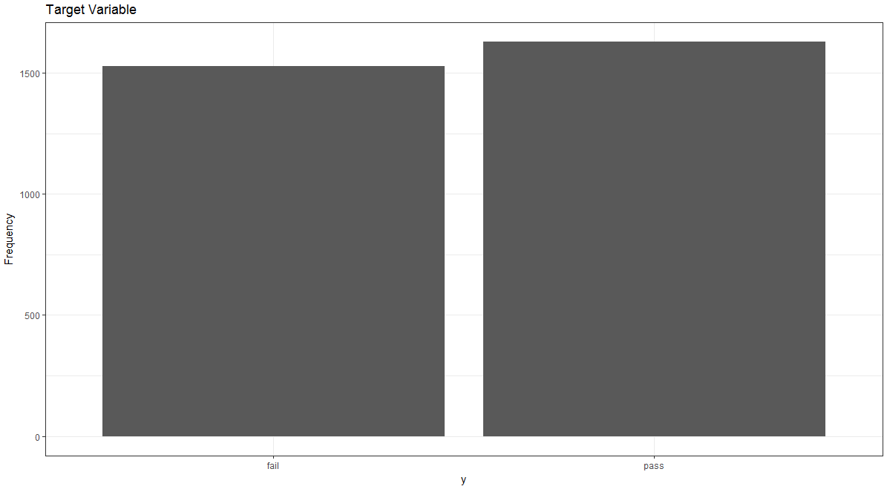
Data Visualization

Slide 9
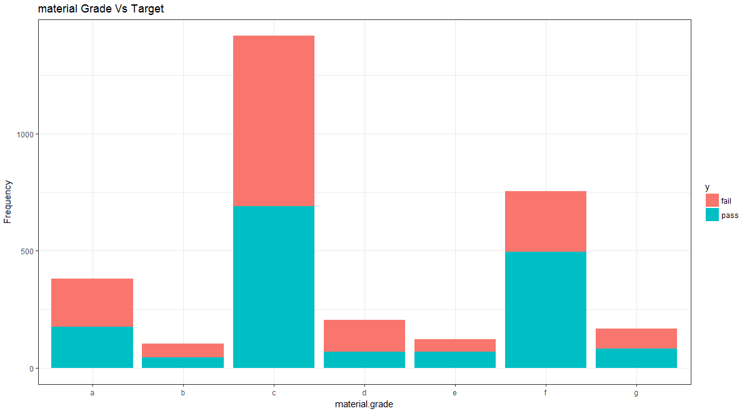
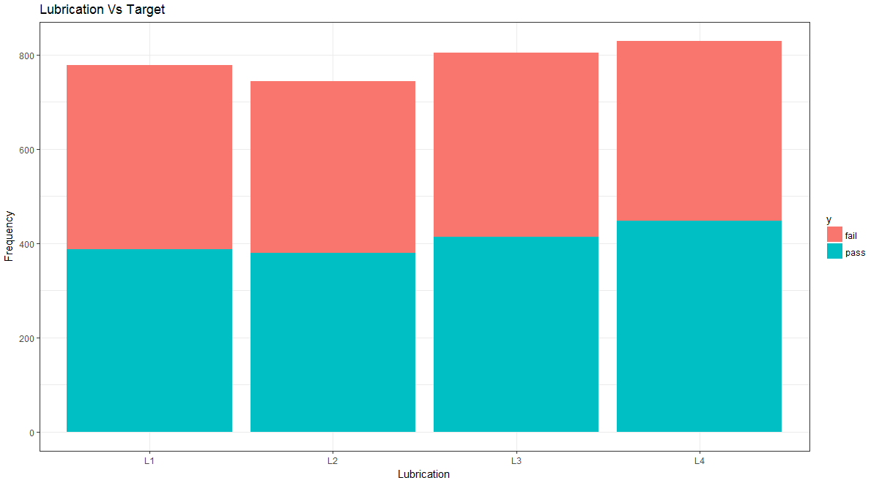
Data Visualization

Slide 10
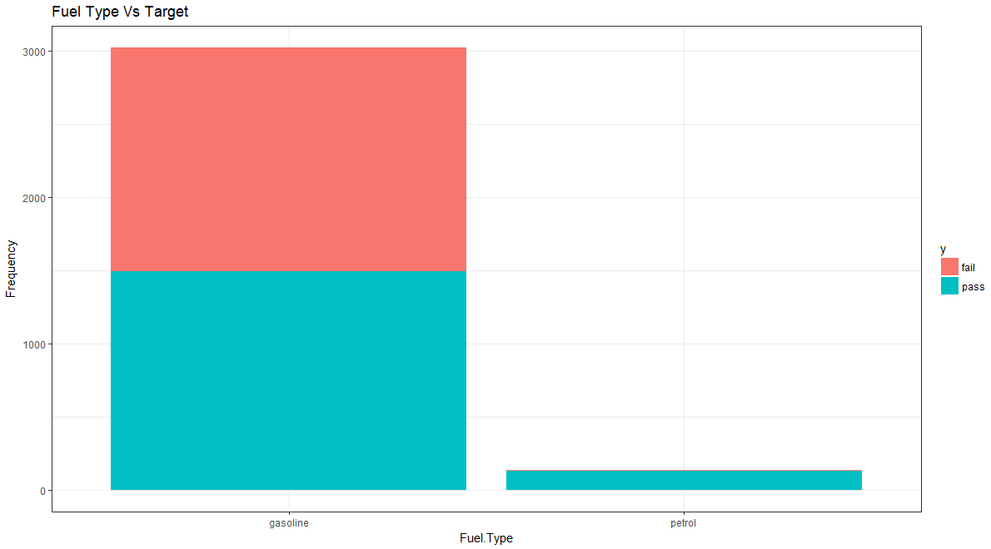
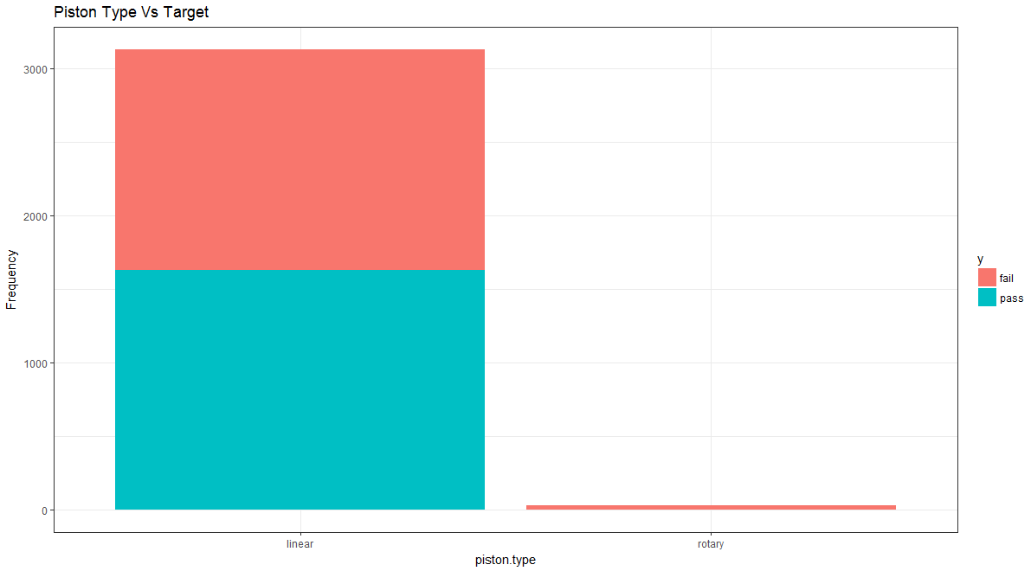
Data Visualization

Slide 11
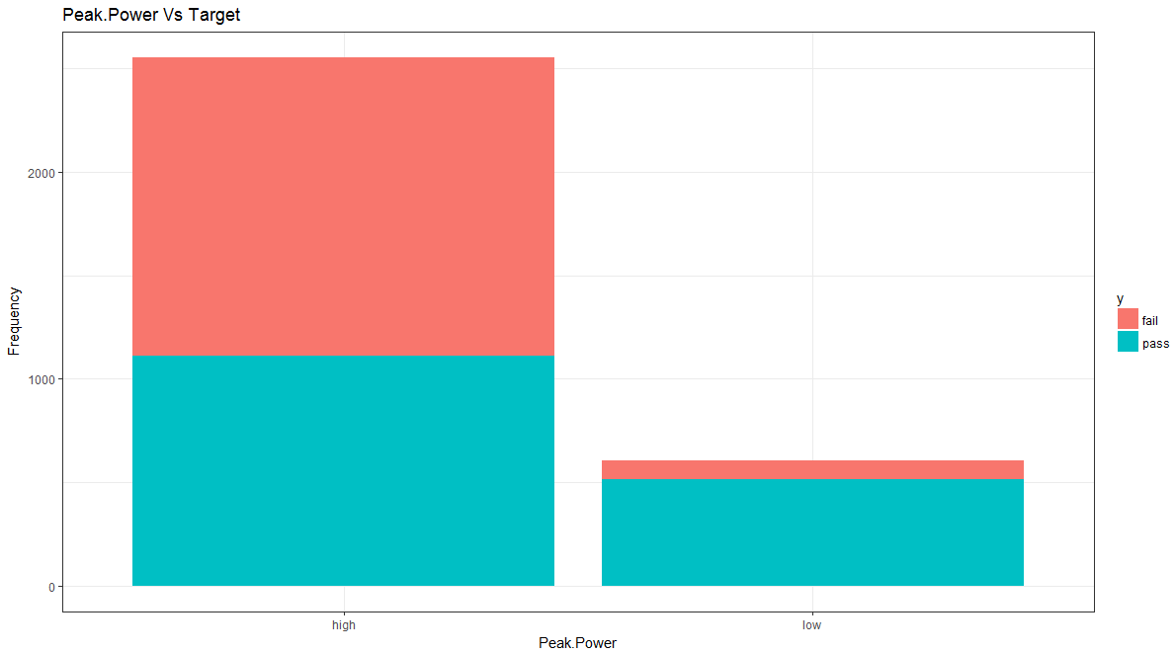
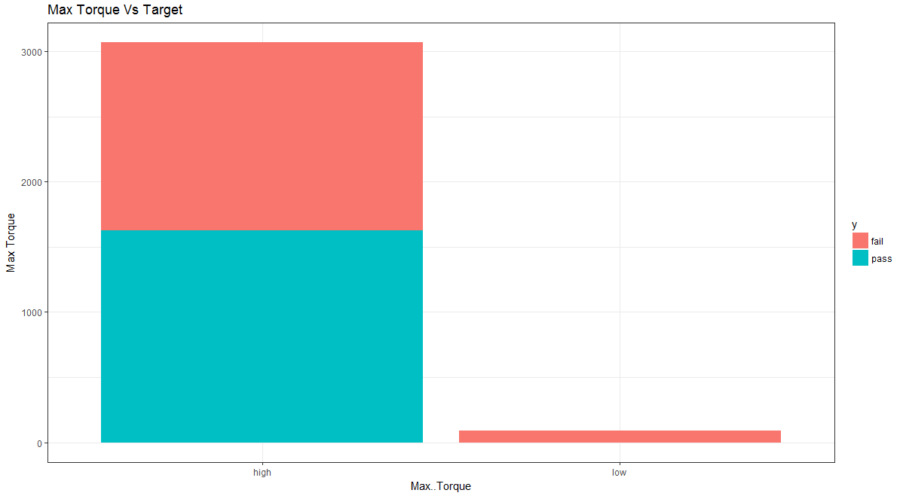
Data Visualization

Slide 12
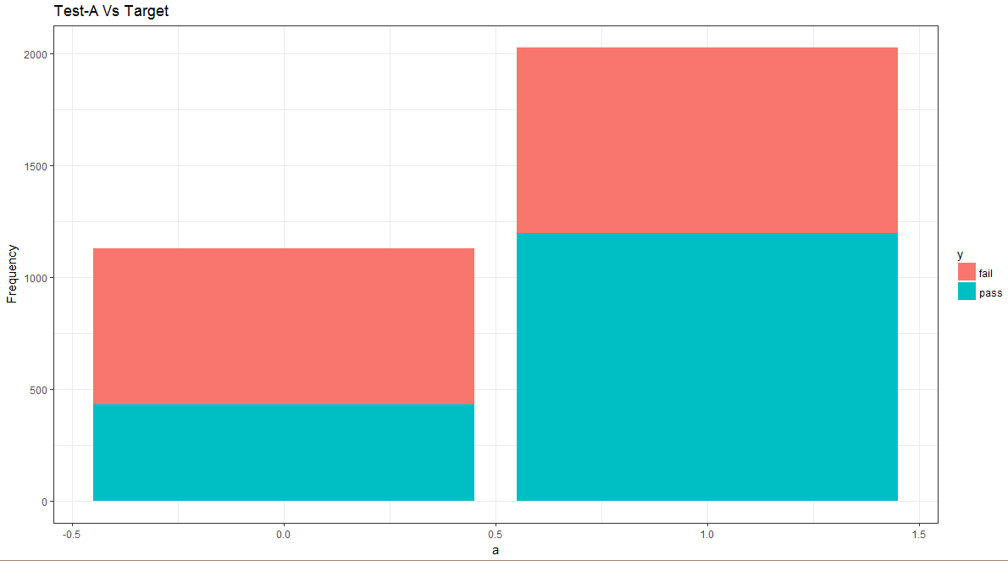
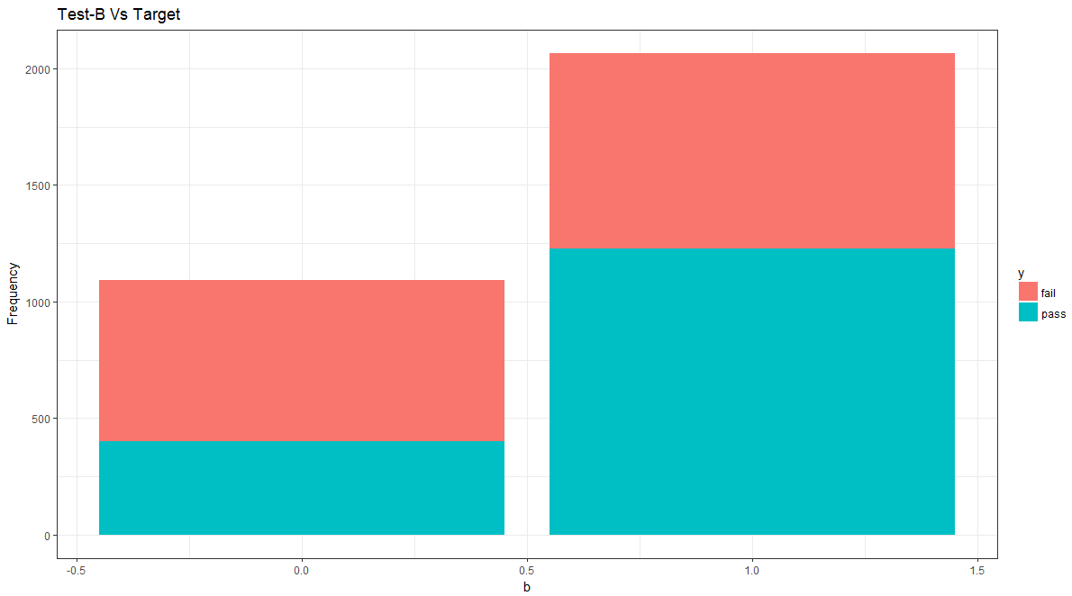
Data Visualization

Slide 13
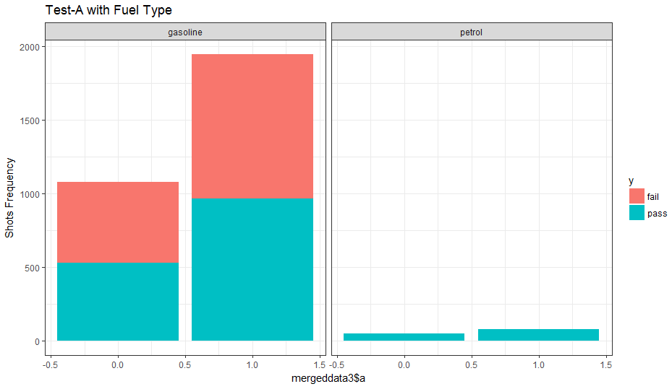
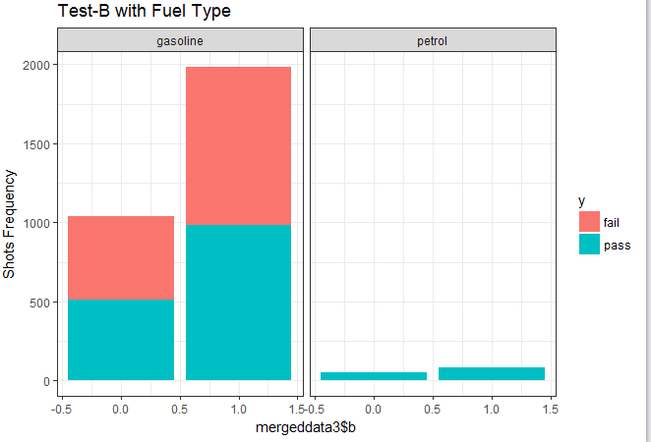
Data Visualization

Slide 14
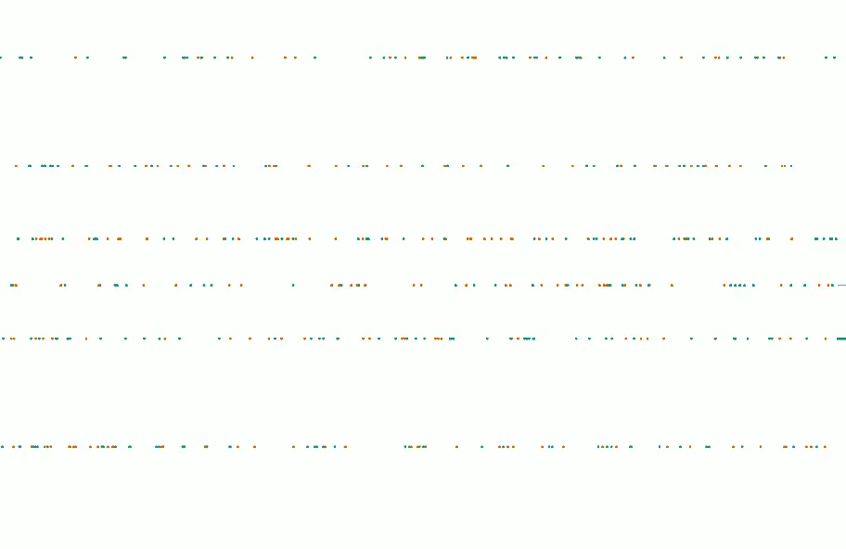

Slide 15
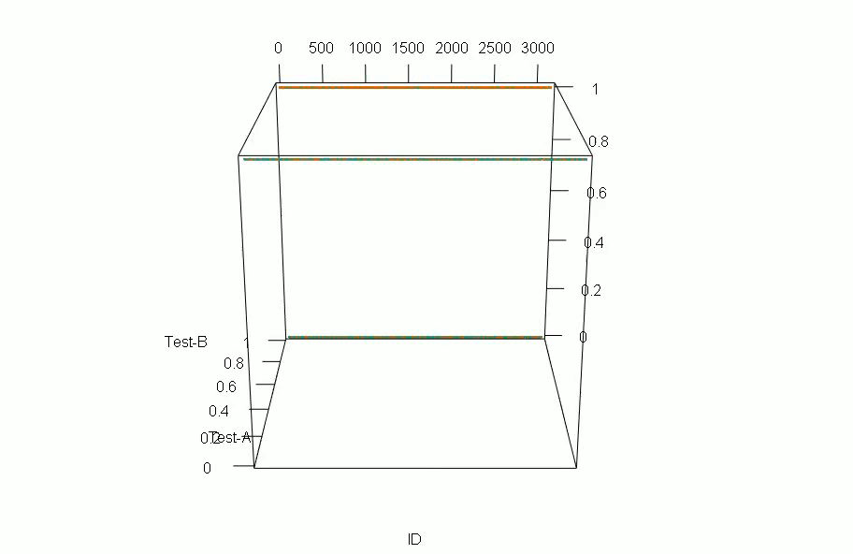

Slide 16
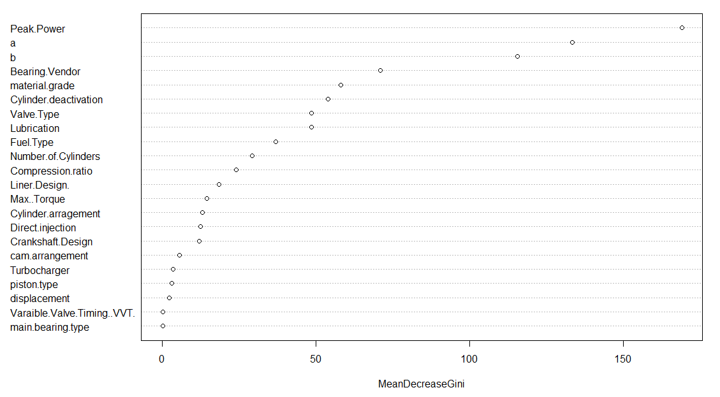
Variable Importance

Slide 17
Model Building
Logistic Regression
Naïve Baise
Decision Trees- C.50, CART
Random Forest
Ada Boost
Gradient Boosting Method(GBM)
XG Boost
SVM
K-fold cross validation with all ML Algorithms
MLP(python)
CNN(Python)

Slide 18
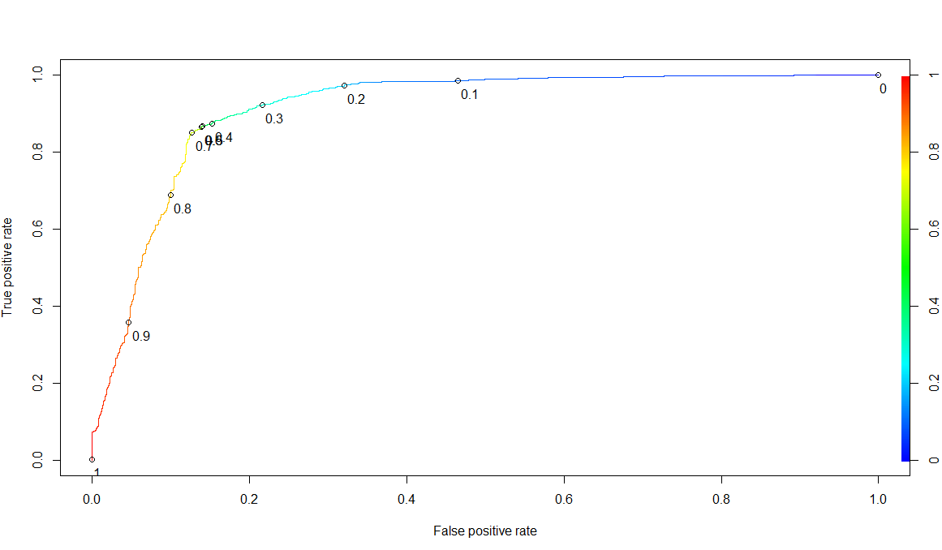
Logistic Regression
AUC-91.31

Slide 19
Logistic regression
With central imputation
With Knn Imputation
Logistic Regression | Accuracy | Specificity | Sensitivity
Train | 86.15 | 86.07 | 86.23
Validation | 87.32 | 87.34 | 87.30
Logistic Regression | Accuracy | Specificity | Sensitivity
Train | 86.74 | 79.91 | 93.16
Validation | 86.68 | 81.00 | 92.01

Slide 20
Naïve Bayes
Naïve Baise | Accuracy | Specificity | Sensitivity
Validation | 87.32 | 87.34 | 87.30

Slide 21
Decision Trees
C.50 | Accuracy | Specificity | Sensitivity
Test | 86.79 | 86.77 | 86.81
CART | Accuracy | Specificity | Sensitivity
Train | 85.7 | 85.30 | 86.08
Validation | 87.32 | 87.56 | 87.10

Slide 22
Random Forest
Random Forest | Accuracy | Specificity | Sensitivity
Validation | 87.74 | 83.41 | 91.8

Slide 23
Ada Boosting
Ada Boosting | Accuracy | Specificity | Sensitivity
Validation | 87.74 | 90.14 | 85.77

Slide 24
GBM
Central Imputation
GBM | Accuracy | Specificity | Sensitivity
Validation | 86.36 | 90.02 | 83.55

Slide 25
XG Boost
On Central Imputation
On knn Imputation
XGB | Accuracy | Specificity | Sensitivity
Validation | 87.74 | 87.67 | 87.80
XGB | Accuracy | Specificity | Sensitivity
Validation | 88.16 | 88.79 | 87.60

Slide 26
SVM
On Central Imputation
On Knn Imputation
SVM | Accuracy | Specificity | Sensitivity
Train | 86.43 | 85.91 | 86.91
Validation | 87.84 | 87.53 | 88.14
SVM | Accuracy | Specificity | Sensitivity
Train | 87.01 | 87.32 | 86.74
Validation | 88.37 | 88.67 | 88.10

Slide 27
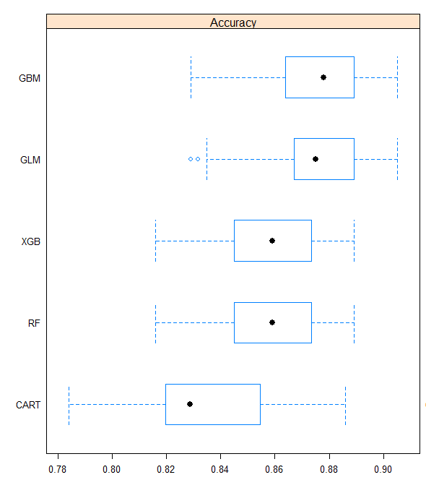
K-fold cross validation with ML Algorithms

Slide 28
Neural Networks
MLP
10 fold cross validation
20 epochs
Batch size-64
4 Hidden Layers
Activation functions- ReLu
Result-86.47 % accuracy.
CNN
5 fold cross validation
20 epochs
Batch size-128
4 hidden Layers with 64 filters
Activation functions-ReLu
Result-87.17% accuracy

Slide 29
Conclusion
SVM model produced the best result with an accuracy of 88.37% with a balanced specificity and sensitivity

Slide 30
Thank You

